Slide 1
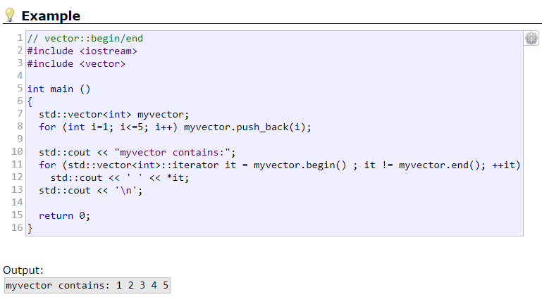
Feedback from last week’s lab session
In the documentation, all example codes can be run online, which can be good place to start your code.
Remember that iterators are just like pointers, i.e. they do provide access to memory content using “*” (i.e. *it).
Use the copy algorithm “copy” when
initialising a container from another.
Click here

